Slide 1
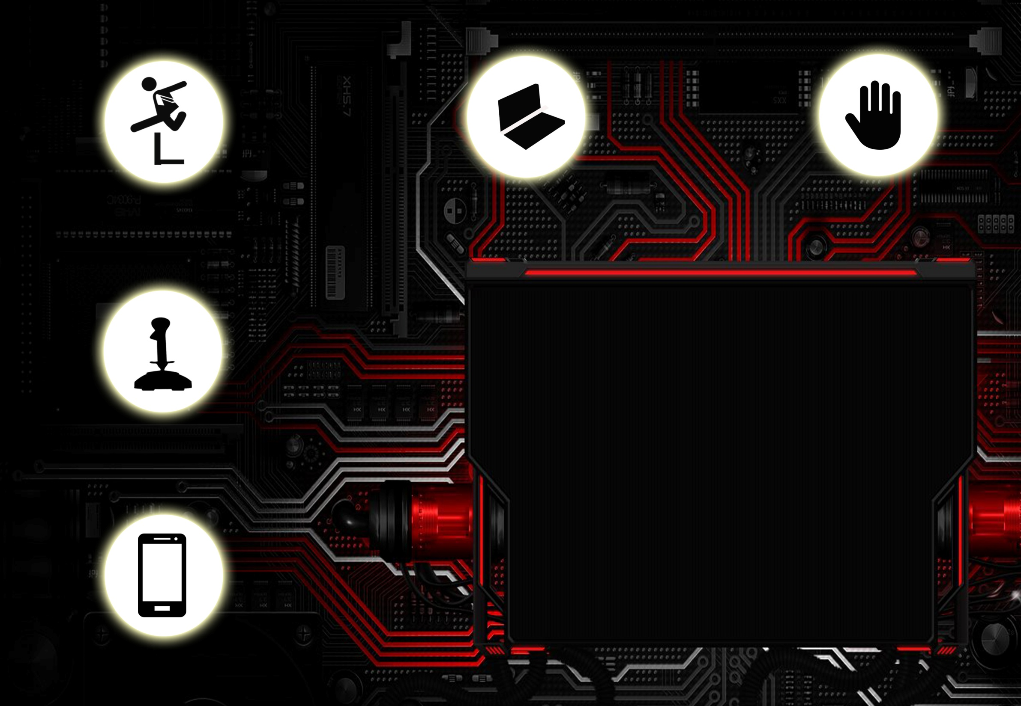
Gesture Controlled Robot
IMPLEMENTATION SESSION

Slide 2
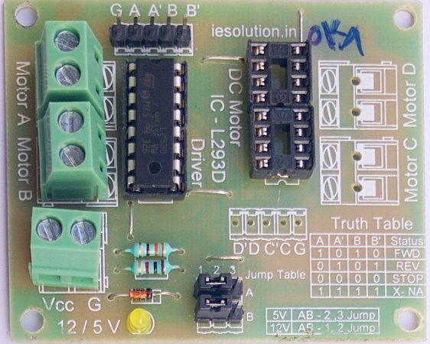
Connections: Motors -> L293D
The Motors have a RED wire and a BLACK wire.
Each of these wires is to be connected to MOT1 and MOT2 ports on the L293D.
The BLACK wire is to be connected to the side the port labels are printed on as illustrated below.

Slide 3
Connections: Arduino -> L293D
The following connections have to be made between the two boards :
A -> PIN 5
A’ -> PIN 4
B -> PIN 3
B’ -> PIN 2
Note : The pins mentioned are the Digital Pins and not the Analog ones.

Slide 4
Connections: Arduino -> ADXL335
The following connections are to be made between the two boards :
A1 -> VCC A2 ->X_OUT A3 -> Y_OUT A4 -> Z_OUT
A5 -> GND

Slide 5
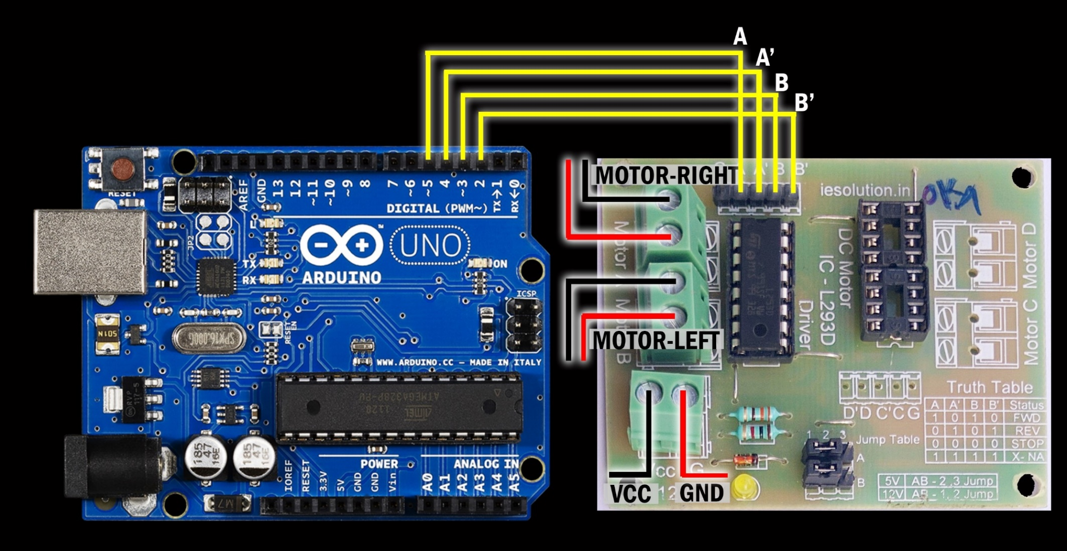
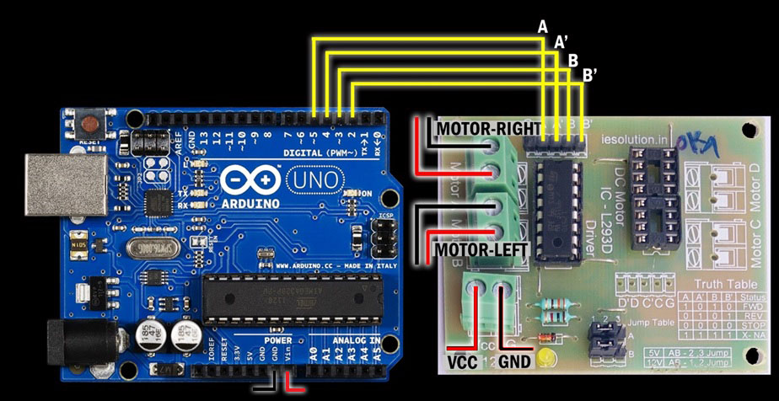
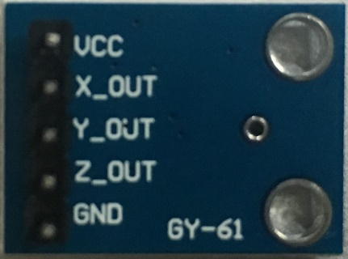

Slide 6


Slide 7
Uploading Program:
Your connections are now ready.
Make sure to remove the jumper wire to the GND pin on the Arduino board coming from L293D board before uploading.
Connect the USB to the USB port.
Switch on the USB communication.
Open Arduino IDE.
Compile and upload the program.

